Slide 1
Chapter 19

Slide 2
Objectives

Slide 3
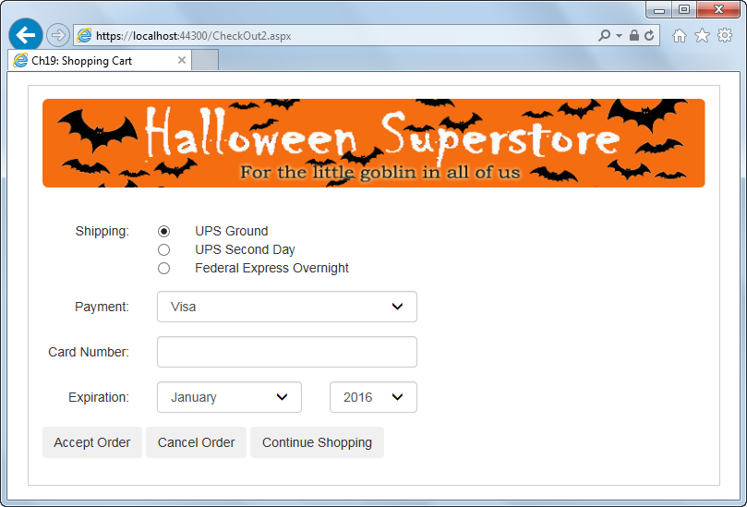
A page that was requested with a secure connection
The URL starts with https:

Slide 4
Types of digital secure certificates

Slide 5
Common certification authorities that issue digital secure certificates

Slide 6
How digital secure certificates work

Slide 7
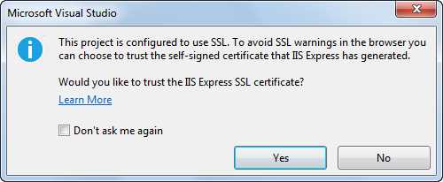
The dialog box that’s displayed when you run a TLS/SSL enabled application

Slide 8
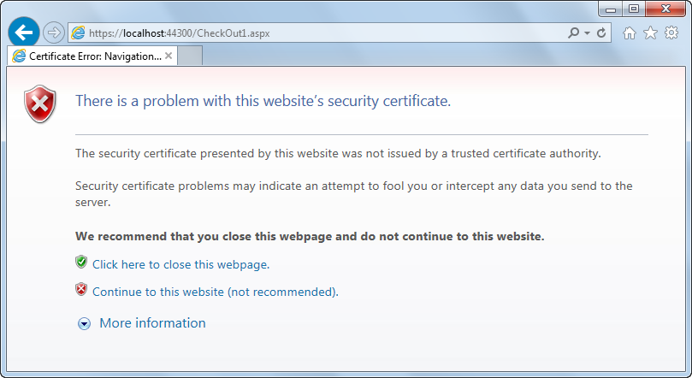
The page that’s displayed in IE if you choose not to trust the certificate

Slide 9
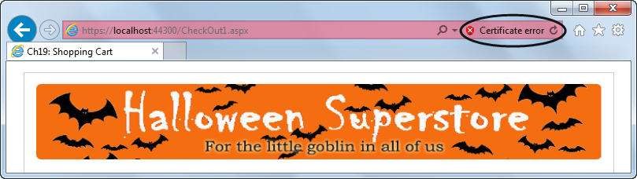
The address bar in IE if you continue to the website

Slide 10
A URL that requests a secure connection for IIS Express

Slide 11
A Web.config file that defines secure and unsecure path settings

Slide 12
Code that retrieves the secure application path from the Web.config file

Slide 13
Code that returns to an unsecured connection

Slide 14
Properties of the HttpRequest class for working with secure connections

Slide 15
A Page_Load method that forces the page to use a secure connection

Slide 16
A statement that replaces the HTTP protocol with the HTTPS protocol

Slide 17
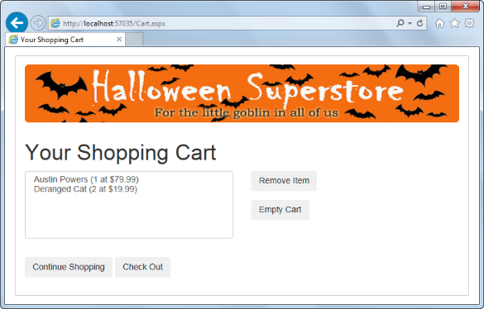
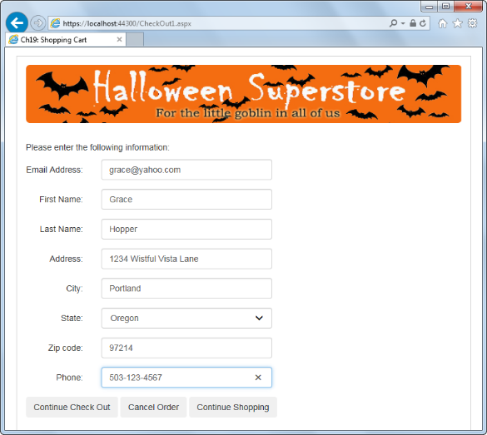
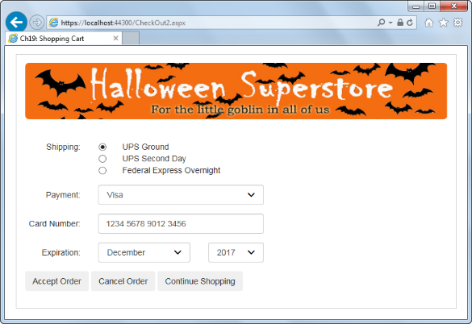
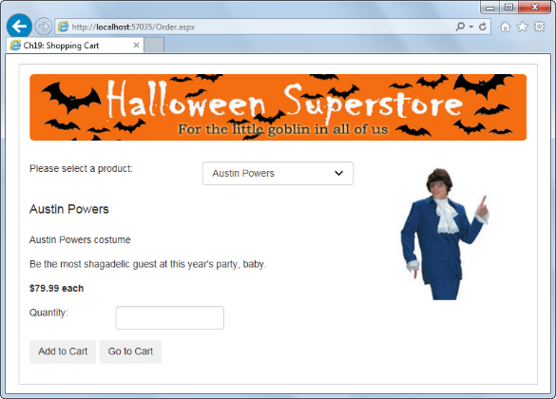
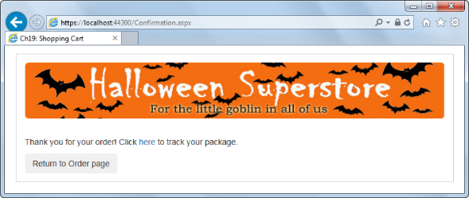
The security for the Shopping Cart application
Cart.aspx
CheckOut1.aspx
Secure
CheckOut2.aspx
Order.aspx
Confirmation.aspx
Unsecure

Slide 18
C# code for the Cart page

Slide 19
C# code for the first Check Out page

Slide 20
C# code for the first Check Out page (cont.)

Slide 21
C# code for the second Check Out page

Slide 22
C# code for the second Check Out page (cont.)

Slide 23
C# code for the Confirmation page

Slide 24
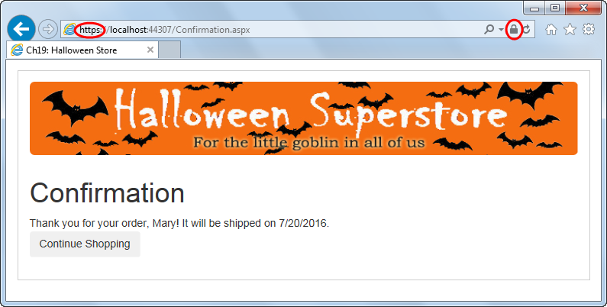
Extra 19-1 Add security to the Halloween
Store application

